Slide 1
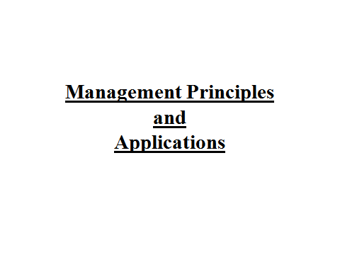

Slide 2
Unit 1
Introduction to Management
Meaning and Definition –
Kimbol and Kimbol
“Management embrace all duties and functions that, pertain to the initiation of an enterprise, its financing, the establishment of all major policies, the provision of all necessary equipments, the outlining the general form of organization under which the enterprise is to operates and the selection of the principal officers.”
Henry Fayol
“To manage is to forecast and plan, to organize, to command, to coordinate and control.”

Slide 3
George Terry
“ A process consisting of planning, organizing, actuating and controlling, performed to determine and accomplish the objectives by use of people and resources”
Peter Drucker
“Management is principally the task of planning, coordinating, motivating, and controlling the efforts of others towards a specific objective”

Slide 4
Need for Study
Important role in modern business
Proper utilization of limited resources
Internal and external co-ordination
Survival and growth
Efficiency in large scale production
Right use of modern inventions
Solving personnel problems
Discharging social responsibilities

Slide 5
Contribution Towards Development of Management Theory
Elton Mayo –
George Elton Mayo born on 1880 in Australia. He was psychologist, industrial researcher and organization theorist. Mayo was formally trained at the University of Adelaide acquiring Bachelor of Arts Degree.
Hawthorne Experiment –
The Hawthorne studies were conducted on workers at the Hawthorne plant of the Western Electric Company by Elton Mayo and Fritz Roethlisberger in the 1920s. The Hawthorne Studies were part of a refocus of managerial strategy incorporating the socio – psychological aspects of human behavior in organization.

Slide 6
Implications of Hawthorne Experiment
Hawthorne experiment consists of four parts –
Illumination Experiment
Relay Assembly Test Room Experiment
Interview Program
Back Wiring Test Room Experiments
Limitations Hawthorne Experiment
Human Relations
Ethical Motivation
Personnel Counseling
Informal Group

Slide 7
Peter Drucker
Peter Drucker was born on 19 November 1909 in Austria . He was psychologist and sociologist. He worked as an bank officer journalist, economist, professor, writer in Europe.
Peter Ducker’s contribution towards management theory
Management a Discipline as well as Profession
Functions of Management
Decentralization of Management
Knowledge Worker
Organization of Business

Slide 8
M.B.O.
Define Organizational Goal
Performance Appraisal
Define Employee Objectives
Process
Of
MBO
Providing Feedback
Employee Authority & Responsibility
Performance Evaluation
Continuous Monitoring Performance and Progress

Slide 9
Different Approaches to Management
Classical Theory
Max Weber’s Bureaucratic Model
Taylor’s Scientific Management Approach
Neo Classical Theory
Human Relations movement
Human Behavioral Approach
Modern Theory
Quantitative Approach
System Approach
Fayol’s Administrative Approach
George Elton Mayo
Merry Parker Follet
Contingency Approach

