Slide 1
Unit II
Planning and Decision Making
Meaning - A basic management function involving formulation of one or more detailed plans to achieve optimum balance of needs or demands with the available resources. The process of making plans for something.
Definition of Planning-
"Mass production methods call for detailed planning"

Slide 2
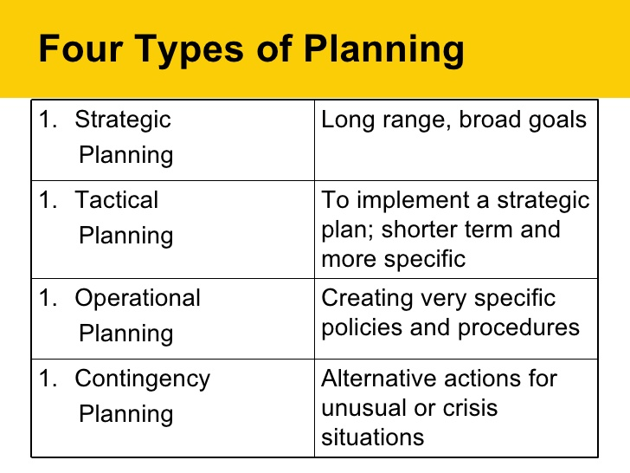

Slide 3
Environmental Analysis and Diagnosis (Internal and External )
Definition-
A. Kenith:
“Environment of the company means pattern of all external influences that affect its life and development.”

Slide 4
Business Environment
External Environment
Macro Environment
Economic Environment
Technological Environment
Socio Cultural Environment
Political Environment
Micro Environment
Customer
Competitor
Supplier
Society
Marketing Intermediaries
Internal Environment
Plant
and Machinery
Financial Resources
Business Plans and Policies
Corporate Image of Business
Human Resources

Slide 5
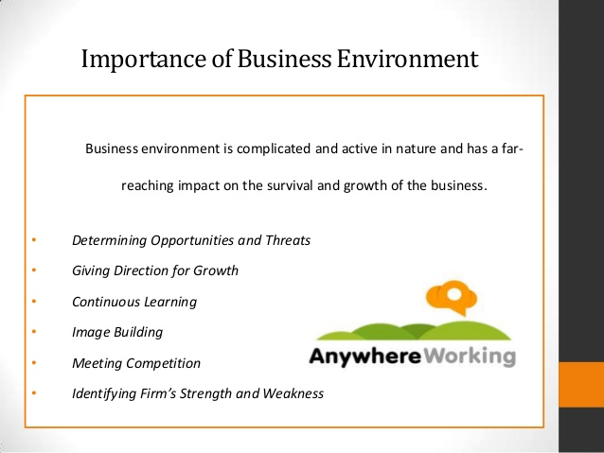

Slide 6
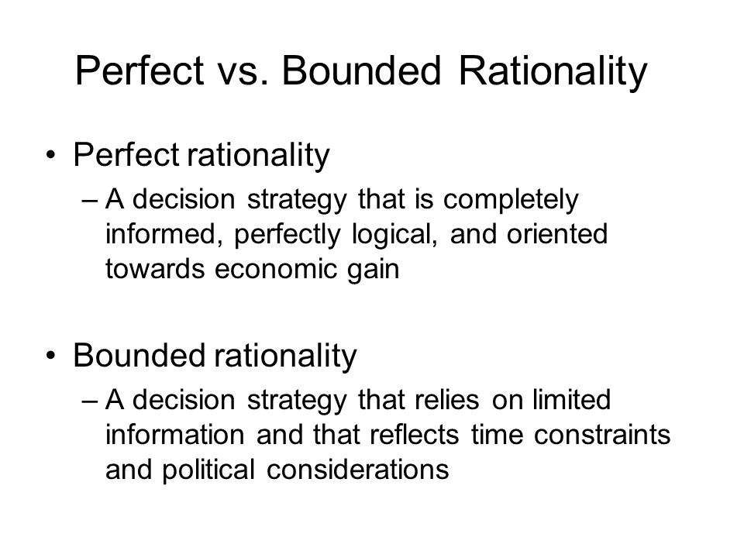
Decision Making Process

Slide 7
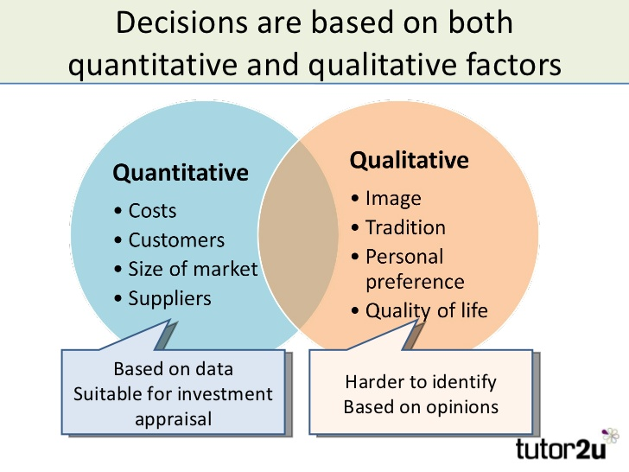
Techniques of Decision Making

Slide 8
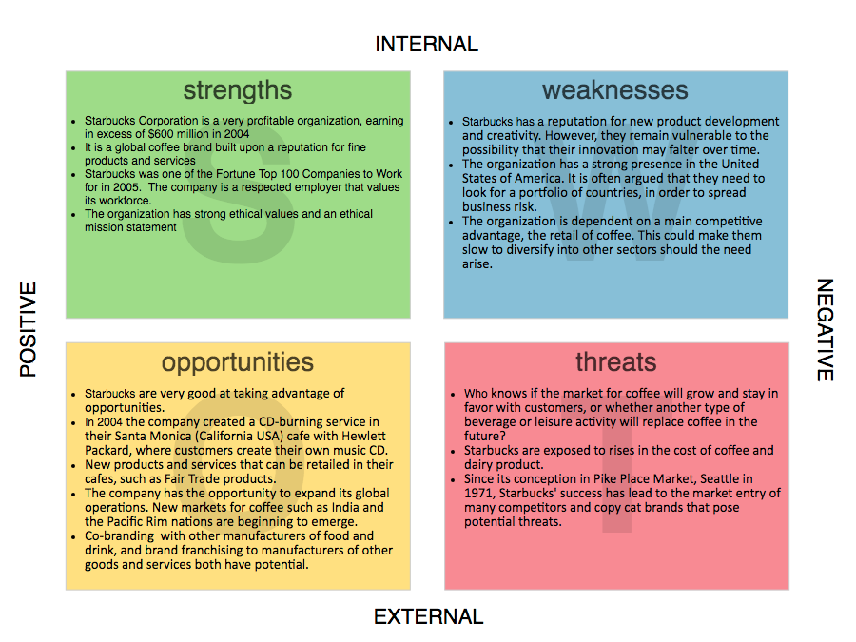
SWOC ANALYSIS

