Slide 1
Unit III
Organizing
Meaning and Definition –
Chester Bernard-
“An organization is a system of consciously co-ordinated activities or forces of two or more person”

Slide 2
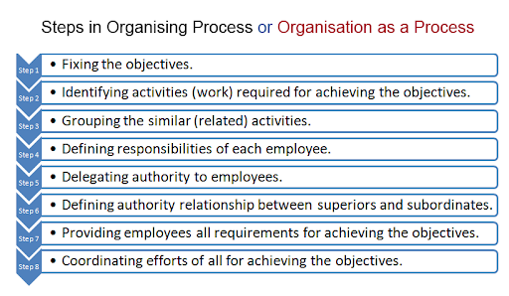
The Process/Steps of Organization

Slide 3
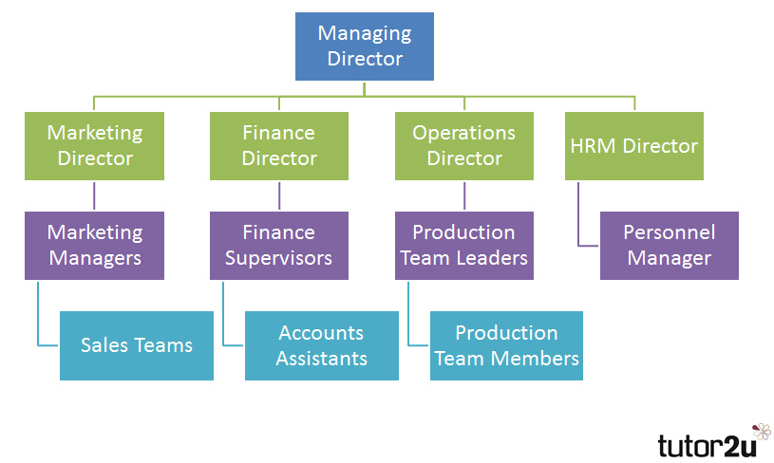
Organization Chart

Slide 4
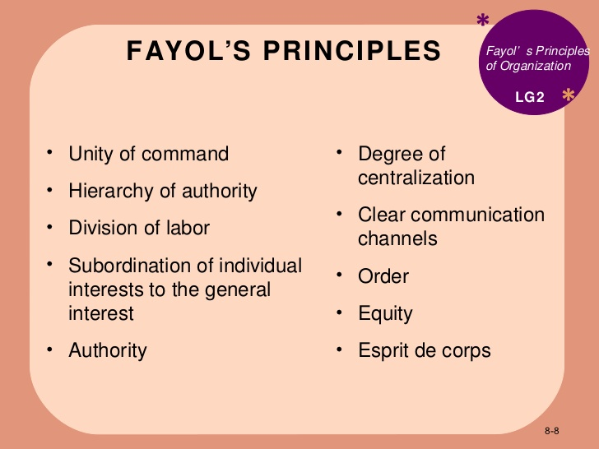
Principles of Organizing

Slide 5
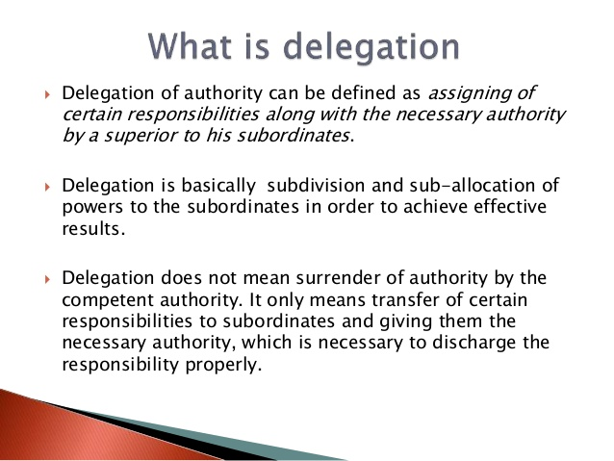
Delegation of Authority
Meaning

Slide 6
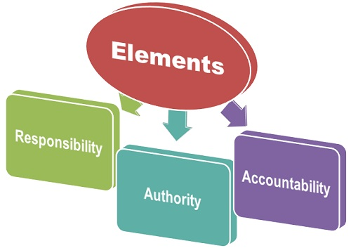
Elements Of Delegation of Authority

Slide 7
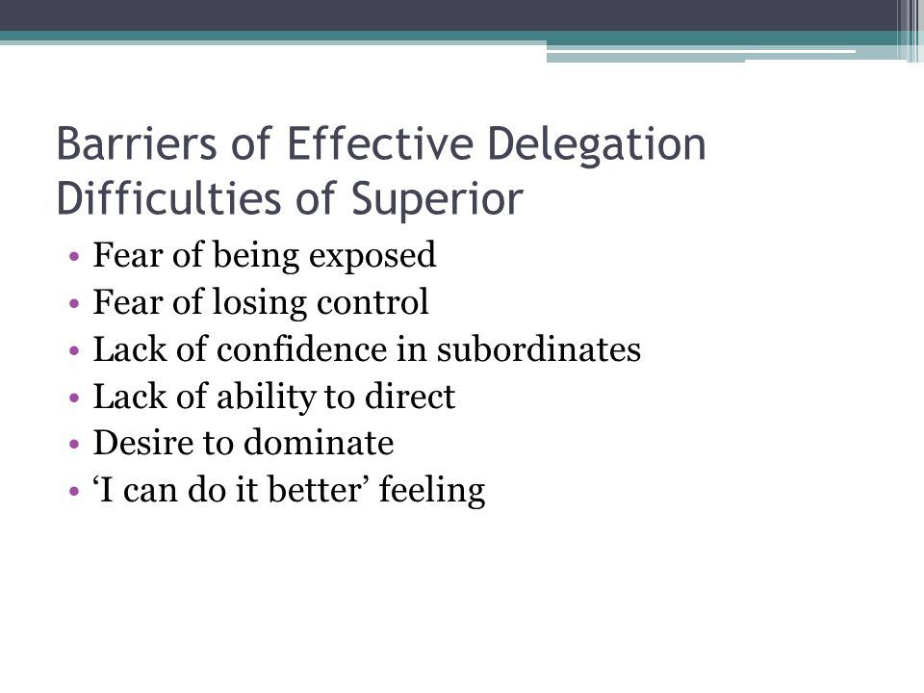
Difficulties in Delegation

Slide 8
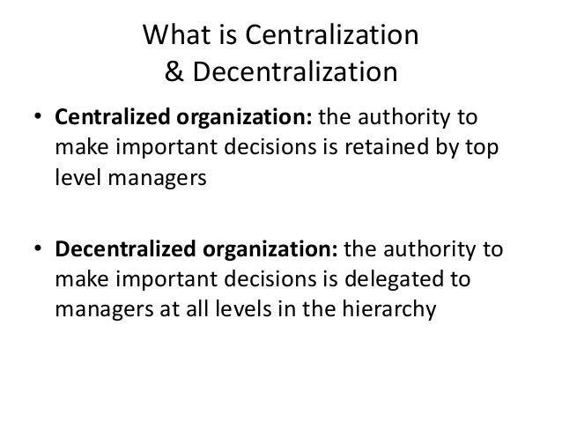

Slide 9
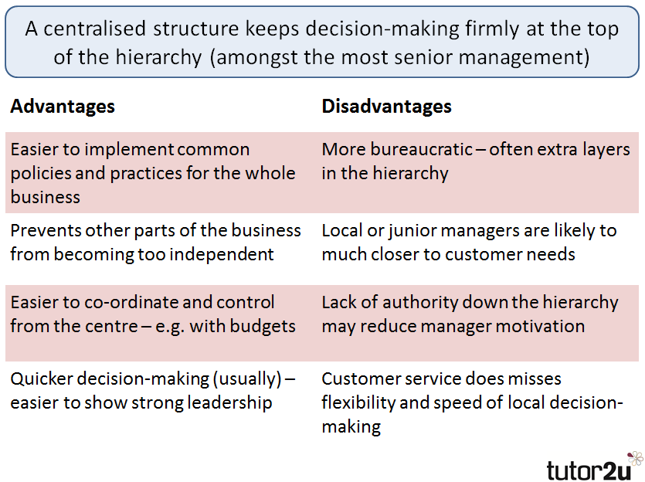
Centralization Advantages and Disadvantages

Slide 10
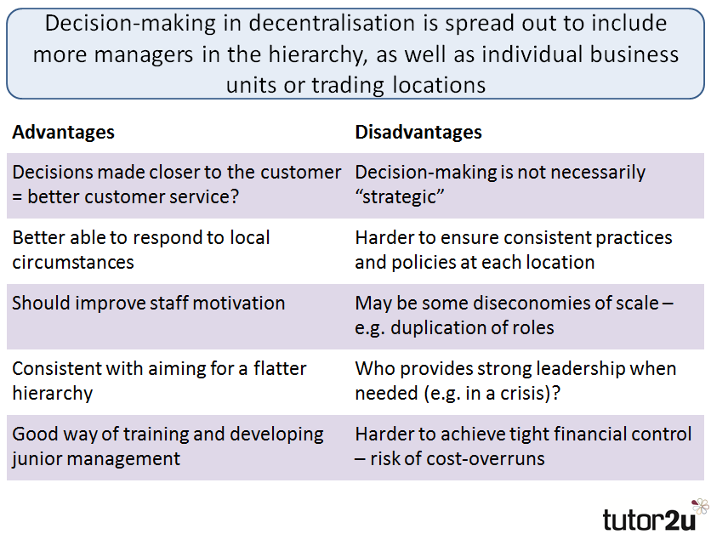
Decentralization - Advantages and Disadvantages

Slide 11
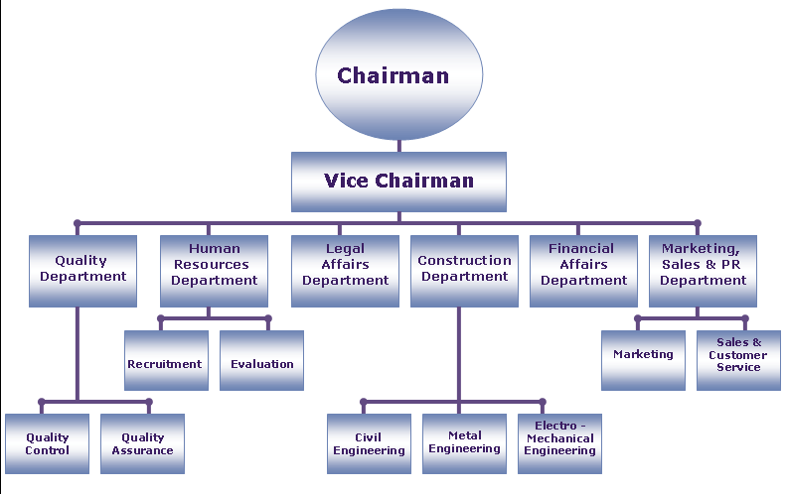
Organization Structure

Slide 12
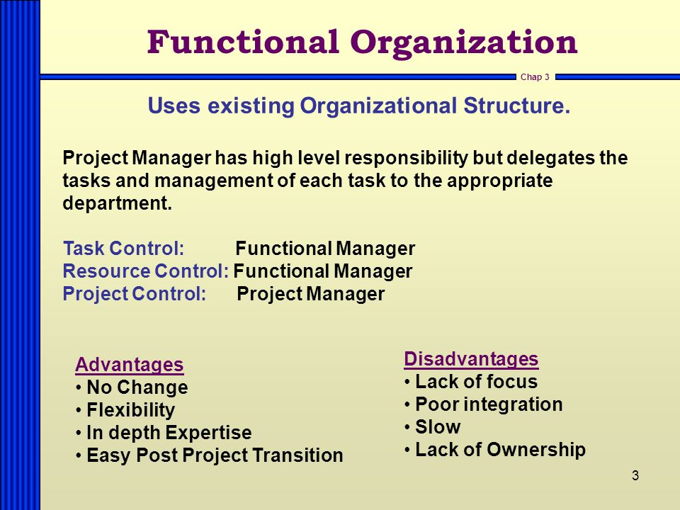

Slide 13
