Slide 1


Slide 2
Unit I
Introduction to Human Resource Management

Slide 3
Concept - Human resource management means management of people at work. HRM is the process which binds people with organizations and helps both people and organization to achieve each others goal.
Various policies, processes and practices are designed to help both employees and organization's to achieve their goal.

Slide 4
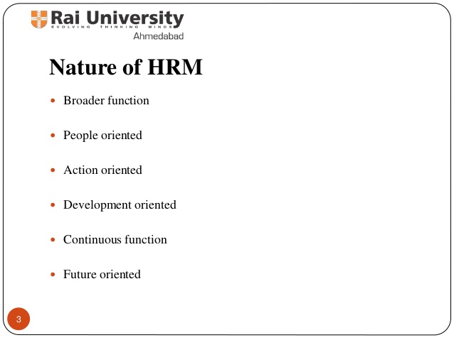

Slide 5
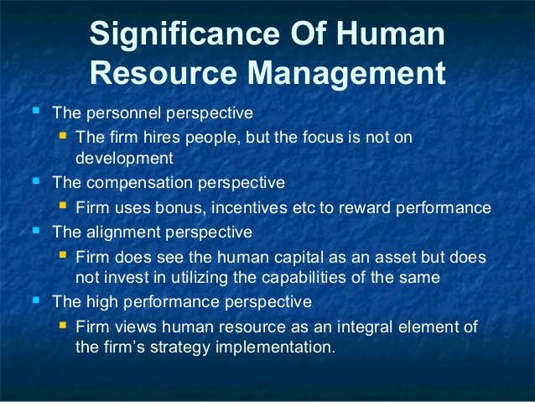

Slide 6
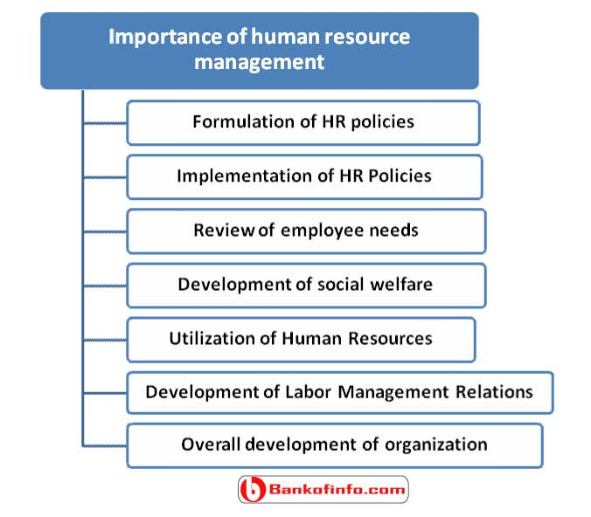

Slide 7
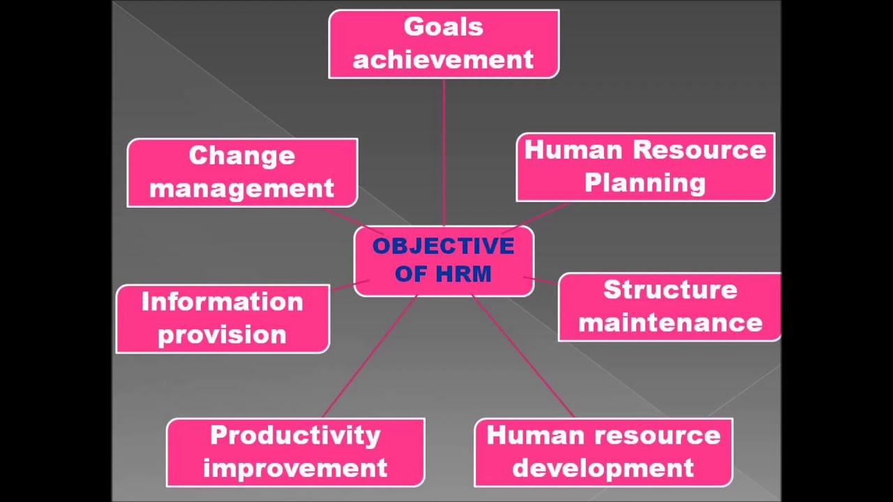

Slide 8
